Slide 1



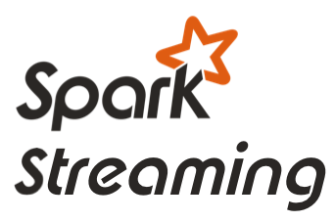





GLOBAL ANOMALY DETECTION WITH ECS - ARCHITECTURE
1. Messages from “things” are sent to Kafka.
2. A Spark Streaming job receives messages, enriches them, performs near real-time anomaly detection, and sends the enriched data to Kafka.
4. Flume persists the enriched data to an ECS bucket.
5. ECS asynchronously replicates the entire bucket to other sites.
6. Data scientists can explore and visualize the global dataset using Zeppelin.
Model
7. A nightly Spark batch job executes on the entire global dataset stored on ECS to produce a machine learning model that detects anomalies.
London
New York
http://bit.ly/1QcYwst
Notes:
For details, see https://community.emc.com/people/claudio_fahey/blog/2016/03/30/global-anomaly-detection-in-iot-with-ecs.

Slide 2
Model
London
New York

